Slide 1
C++ Plus Data Structures
Nell Dale
David Teague
Chapter 8
Binary Search Trees

Slide 2
Jake’s Pizza Shop
Owner
Jake
Manager Chef Brad Carol
Waitress Waiter Cook Helper
Joyce Chris Max Len

Slide 3
A Tree Has a Root Node
Owner
Jake
Manager Chef Brad Carol
Waitress Waiter Cook Helper
Joyce Chris Max Len
ROOT NODE

Slide 4
Leaf nodes have no children
Owner
Jake
Manager Chef Brad Carol
Waitress Waiter Cook Helper
Joyce Chris Max Len
LEAF NODES
Notes:
- 자식이 없는 노드

Slide 5
A Tree Has Levels
Owner
Jake
Manager Chef Brad Carol
Waitress Waiter Cook Helper
Joyce Chris Max Len
LEVEL 0

Slide 6
Level One
Owner
Jake
Manager Chef Brad Carol
Waitress Waiter Cook Helper
Joyce Chris Max Len
LEVEL 1

Slide 7
Level Two
Owner
Jake
Manager Chef Brad Carol
Waitress Waiter Cook Helper
Joyce Chris Max Len
LEVEL 2
What is the Height of a tree?

Slide 8
A Subtree
Owner
Jake
Manager Chef Brad Carol
Waitress Waiter Cook Helper
Joyce Chris Max Len
LEFT SUBTREE OF ROOT NODE

Slide 9
Another Subtree
Owner
Jake
Manager Chef Brad Carol
Waitress Waiter Cook Helper
Joyce Chris Max Len
RIGHT SUBTREE
OF ROOT NODE

Slide 10
Binary Tree
A binary tree is a structure in which:
[1]Each node can have at most two children, and [2] in which a unique path exists from the root to every other node.
The two children of a node are called the left child and the right child, if they exist.
Notes:
이진 트리
각 노드는 최대 2개의 자 노드를 갖는다.
Root로부터 각 노드를 연결하는 고유한 path가 존재
한 노드의 두 자식은 left child와 right child라 부른다.

Slide 11
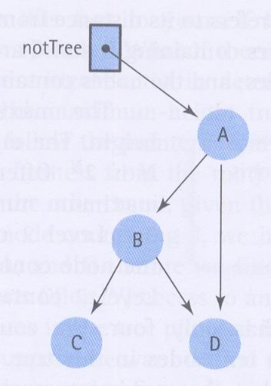
Binary Tree? If not, why?
Notes:
- Root로부터 D까지 2개의 path가 존재한다. 즉 unique path condition을 위반

Slide 12
A Binary Tree
Height?
V
Q
L
E
T
A
K
S
Notes:
Binary search를 할 수 있다. 즉 Binary Tree는 리스트를 배열을 사용하지 않고 binary search를 가능하게 한다.
최소 높이: log₂N+1 최대 높이 : N

Slide 13
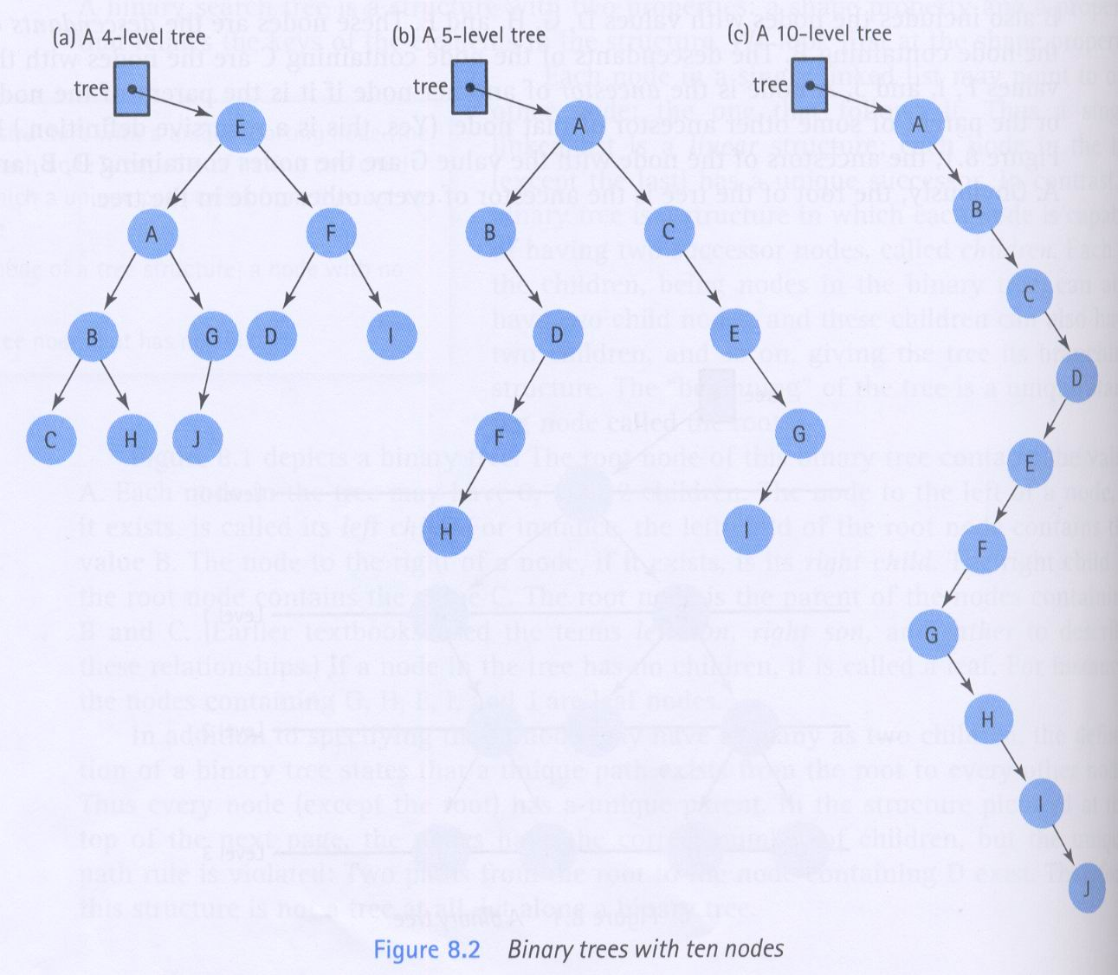
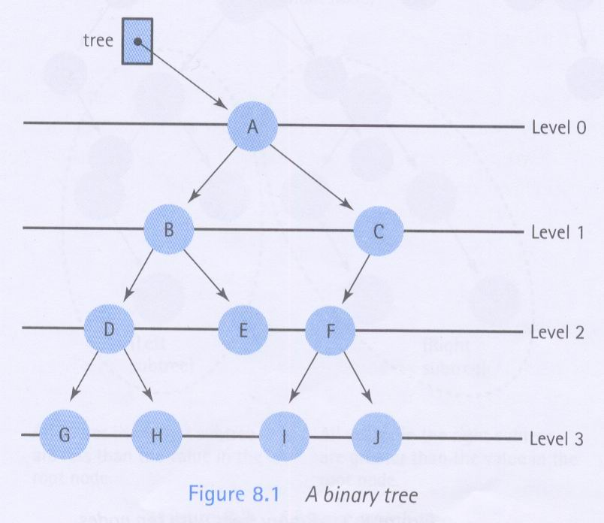
Level & Balance
The max. number of nodes that a N level tree can have?
Relation between the search time and the number of level.
Max. number of nodes that each level can have.
Notes:
완전히 차 있을 때로 1+2+4+ .. + 2^{N}

Slide 14
How many leaf nodes?
V
Q
L
E
T
A
K
S
Notes:
3

Slide 15
How many descendants of Q?
V
Q
L
E
T
A
K
S
E, T, K

Slide 16
How many ancestors of K?
V
Q
L
E
T
A
K
S
T, Q, V
Notes:
. A 노드는 B 노드의 부모라면 A 노드는 B노드의 조상이다. 예 : Q는 T의 부모이기 때문에 T의 조상이다.
. A 노드가 B 노드의 다른 조상의 부모이라면, A 노드는 B 노드이 조상이다. 순환적인 성질은 갖는다.
예: T는 K의 부모이기 때문에 K의 조상이다. Q는 조상 T의 부모이기 때문에 K의 새로운 조상이다., V는 조상 Q의 부모이기 때문에 조상이다.

Slide 17
Implementing a Binary Tree with Pointers and Dynamic Data
V
Q
L
E
T
A
K
S

Slide 18
Each node contains two pointers
template< class ItemType >
struct TreeNode
{
ItemType info; // Data member
TreeNode<ItemType>* left; // Pointer to left child
TreeNode<ItemType>* right; // Pointer to right child
};
NULL ‘A’ 6000
. left . info . right

Slide 19
class TreeType
{
public:
TreeType(); // constructor
~TreeType(); // destructor
TreeType(const TreeType& originalTree); // copy constructor
void operator=(const TreeType& originalTree);
void MakeEmpty();
bool IsEmpty() const;
bool IsFull() const;
void ResetTree(OrderType order);
int LengthIs() const;
void RetrieveItem(ItemType& item, bool& found) const;

Slide 20
// TreeType 계속
void InsertItem(ItemType item);
void DeleteItem(ItemType item);
void GetNextItem (ItemType& item, OrderType order,
bool& finished);
void Print(std::ofstream& outFile) const;
private:
TreeNode* root;
};
struct TreeNode
{
ItemType info;
TreeNode* left;
TreeNode* right;
};

Slide 21
TreeType<char> CharBST;
TreeType
‘J’
~TreeType
Private data:
root
‘E’
‘S’
IsEmpty
InsertItem
‘A’
‘H’
RetrieveItem
PrintTree
.
.
.

Slide 22
A Binary Search Tree (BST) is . . .
A special kind of binary tree in which:
1. Each node contains a distinct data value,
2. The key values in the tree can be compared using “greater than” and “less than”, and
3. The key value of each node in the tree is
less than every key value in its right subtree, and greater than every key value in its left subtree.
Notes:
이진 탐색 트리 : 이진 트리의 특수한 형태
각 노드는 독특한 자료 값을 갖는다.
트리에 있는 키 값은 <와 >로 비교될 수 있다.
각 노드의 키값은 오른쪽 subtree의 키값보다 작고, left subtree의 키값보다 크다.

Slide 23
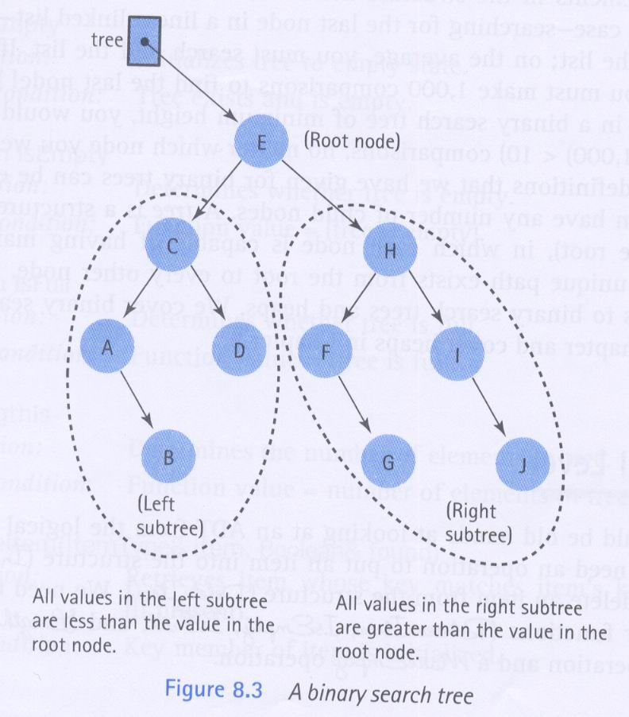
Subtree of a binary tree
Left Tree < Right Tree

Slide 24
Shape of a binary search tree . . .
Depends on its key values and their order of insertion.
Insert the elements ‘J’ ‘E’ ‘F’ ‘T’ ‘A’ in that order.
The first value to be inserted is put into the root node.
‘J’
Notes:
이진 탐색 트리의 형태는 키값들에 따라서 삽입하는 순서에 따라서 달라진다.
첫번째 값은 root node에 저장된다.

Slide 25
Inserting ‘E’ into the BST
Thereafter, each value to be inserted begins by comparing itself to the value in the root node, moving left it is less, or moving right if it is greater. This continues at each level until it can be inserted as a new leaf.
‘J’
‘E’
Notes:
첫 노드와 비교하여
작으면 left subtree로
크면 right subtree로
이 경우 작기 때문에 left로
. Left가 Null이므로 거기에다 E를 삽입한다.

Slide 26
Inserting ‘F’ into the BST
Begin by comparing ‘F’ to the value in the root node, moving left if it is less, or moving right if it is greater. This continues until it can be inserted as a leaf.
‘J’
‘E’
‘F’

Slide 27
Inserting ‘T’ into the BST
Begin by comparing ‘T’ to the value in the root node, moving left it is less, or moving right if it is greater. This continues until it can be inserted as a leaf.
‘J’
‘E’
‘T’
‘F’

Slide 28
Inserting ‘A’ into the BST
Begin by comparing ‘A’ to the value in the root node, moving left it is less, or moving right if it is greater. This continues until it can be inserted as a leaf.
‘J’
‘E’
‘T’
‘A’
‘F’
Notes:
- worst case 탐색에서 비교수는 ?

Slide 29
Summary of Insertion Operation
Recursive Operation
If current pointer==NUL, then insert.
If Key > current key, move to right subtree
If Key < current key, move to left subtree
If Key==current key, end with a error message.

Slide 30
What binary search tree . . .
is obtained by inserting
the elements ‘A’ ‘E’ ‘F’ ‘J’ ‘T’ in that order?
‘A’
Notes:
- Binary Tree의 형태는 키값과 입력되는 순서에 따라서 결정된다.

Slide 31
Binary search tree . . .
obtained by inserting
the elements ‘A’ ‘E’ ‘F’ ‘J’ ‘T’ in that order.
‘A’
‘E’
‘F’
‘J’
‘T’
Notes:
worst case 시 비교수는?
탐색을 위해서 평균비교수가 최소가 되기 위해서는?

Slide 32
Another binary search tree
‘J’
‘E’
‘T’
‘A’
‘H’
‘M’
‘K’
‘P’
Add nodes containing these values in this order:
‘D’ ‘B’ ‘L’ ‘Q’ ‘S’ ‘V’ ‘Z’

Slide 33
Insert ‘D’
‘J’
‘E’
‘T’
‘A’
‘H’
‘M’
‘D’
‘K’
‘P’

Slide 34
Insert ‘B’
‘J’
‘E’
‘T’
‘A’
‘H’
‘M’
‘D’
‘K’
‘P’
‘B’

Slide 35
Insert ‘L’
‘J’
‘E’
‘T’
‘A’
‘H’
‘M’
‘D’
‘K’
‘P’
‘B’
‘L’

Slide 36
Insert ‘Q’ ‘S’ ‘V’ ‘Z’
‘J’
‘E’
‘T’
‘A’
‘H’
‘M’
‘V’
‘D’
‘K’
‘P’
‘Z’
‘B’
‘L’
‘Q’
‘S’

Slide 37
Template<class ItemType>
class TreeType
{
public:
TreeType(); // constructor
~TreeType(); // destructor
TreeType(const TreeType<itemType>& originalTree); // copy constructor
void operator=(const TreeType<itemType>& originalTree);
void MakeEmpty();
bool IsEmpty() const;
bool IsFull() const;
void ResetTree(OrderType order);
int LengthIs() const;
void RetrieveItem(ItemType& item, bool& found) const;
void InsertItem(ItemType item);
void DeleteItem(ItemType item);

Slide 38
// TreeType 계속
void GetNextItem (ItemType& item, OrderType order, bool& finished);
void Print(std::ofstream& outFile) const;
private:
TreeNode<itemType>* root;
QueType<itemType> preQue;
QueType<itemType> inQue;
QueType<itemType> postQue;
};
Template<class ItemType>
struct TreeNode
{
ItemType info;
TreeNode* left;
TreeNode* right;
};

Slide 39
bool TreeType::IsFull() const
// Returns true if there is no room for another item
// on the free store; false otherwise.
{
TreeNode* location;
try
{
location = new TreeNode;
delete location;
return false;
}
catch(std::bad_alloc exception)
{
return true;
}
}
bool TreeType::IsEmpty() const
// Returns true if the tree is empty; false otherwise.
{
return root == NULL;
}

Slide 40

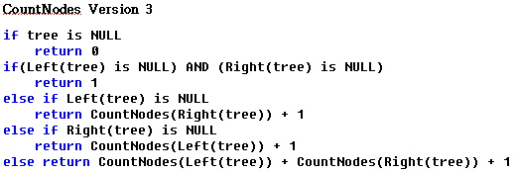
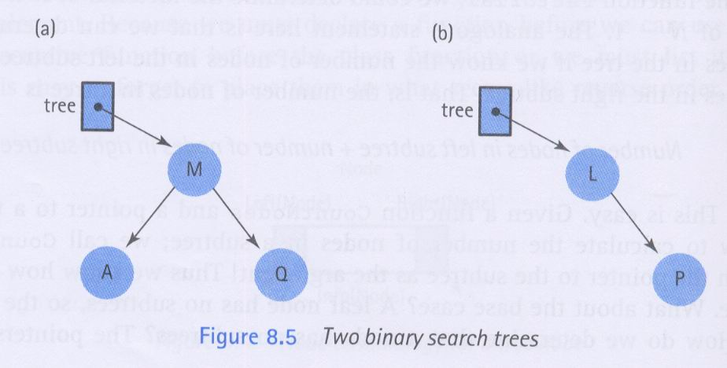
The Function LengthIs
Definition: Count the Number of nodes in tree
Size: Number of nodes in tree
Base Case: If tree is NULL, return 0
General ,,: Return CountNodes(Left( tree))+CountNodes(Right(tree))+1
40
Notes:
CountNodes Version 2 : (그림 8.5b)는 균형이 맞지 않으며, L의 왼쪽 트리만 NULL이기 때문에 첫 번째 문장에 체크 되지 않고 문제 발생
CountNodes Version 3 : 초기에 빈 트리일 때 문제 발생
CountNodes Version 4 : 하나의 base case로 단순화

Slide 41
Function LengthIs()
int CountNodes(TreeNode* tree);
int TreeType::LengthIs() const
// Calls recursive function CountNodes to count the
// nodes in the tree.
{
return CountNodes(root);
}
int CountNodes(TreeNode* tree)
// Post: returns the number of nodes in the tree.
{
if (tree == NULL)
return 0;
else
return CountNodes(tree->left) + CountNodes(tree->right) + 1;
}

Slide 42
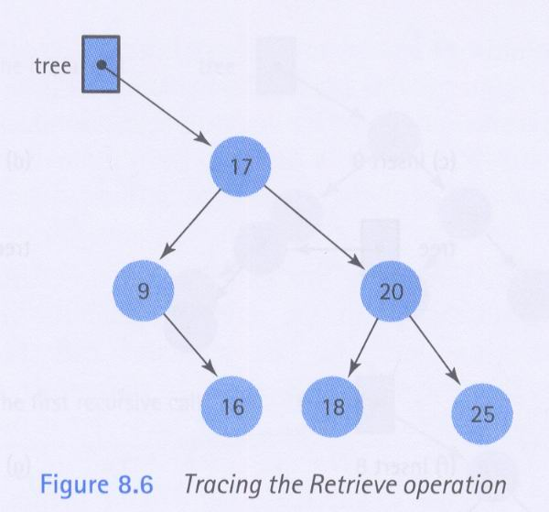
Retrieve Operation
Retrieve 18
Retrieve 21
Function Retrieve(tree, item,found)
Base Case:
If item’s key matches key in Info(tree), item is set to Info(tree) and found is true
If tree==NULL, found is false
General Case:
If item’s key is less than key in Info(tree), Retrieve(Left(tree), item, found);
Else Retrieve(Right(tree),item, found)

Slide 43
template< class ItemType >
void TreeType<ItemType> :: RetrieveItem ( ItemType& item,
bool& found )
{
Retrieve ( root, item, found ) ;
}
template< class ItemType >
void Retrieve ( TreeNode<ItemType>* ptr, ItemType& item, bool& found)
{ if ( ptr == NULL )
found = false ;
else if ( item < ptr->info ) // GO LEFT
Retrieve( ptr->left , item, found ) ;
else if ( item > ptr->info ) // GO RIGHT
Retrieve( ptr->right , item, found ) ;
else
{ item = ptr->info ;
found = true ;
}
}
43

Slide 44
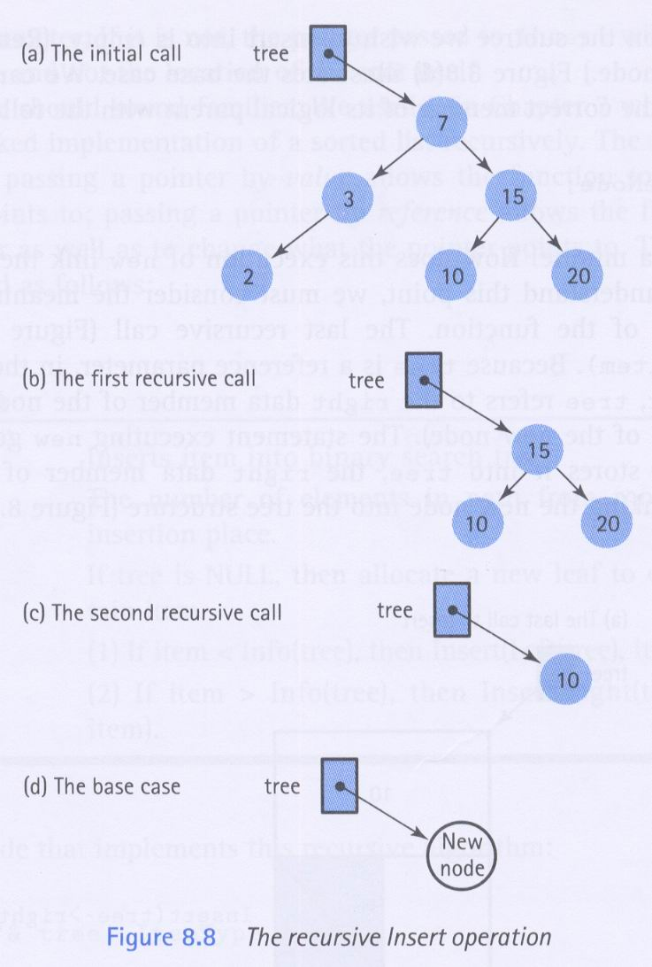
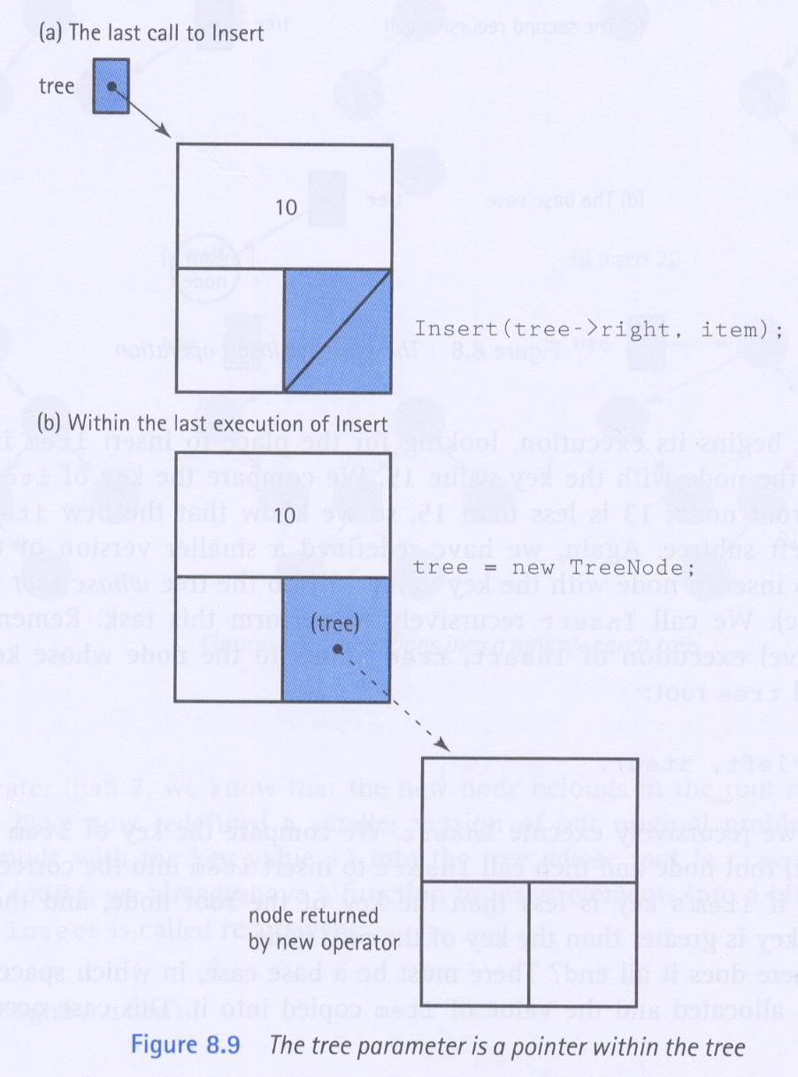
The Function InsertItem
Insert 13
44
Notes:
(그림 8.8a) root가 7을 포함하는 노드에 13의 키 값을 갖는 노드 삽입, 7 < 13
(그림 8.8b) Insert(tree->right, item); 13 < 15, tree는 원래의 root가 아닌 키 값이 15인 노드를 가리킴
(그림 8.8c) Insert(tree->left, item); 10 < 13
(그림 8.8d) Insert(tree->right, item); tree->right가 NULL이므로, leaf 노드로서 item 삽입, tree = new TreeNode;
tree는 레퍼런스 매개변수이기 때문에, tree는 10을 포함하는 노드의 right 데이터 멤버를 참조

Slide 45
template< class ItemType >
void TreeType<ItemType> :: InsertItem ( ItemType item )
{
Insert ( root, item ) ;
}
template< class ItemType >
void Insert ( TreeNode<ItemType>*& ptr, ItemType item )
{ if ( ptr == NULL )
{ // INSERT item HERE AS LEAF
ptr = new TreeNode<ItemType> ;
ptr->right = NULL ;
ptr->left = NULL ;
ptr->info = item ;
}
else if ( item < ptr->info ) // GO LEFT
Insert( ptr->left , item ) ;
else if ( item > ptr->info ) // GO RIGHT
Insert( ptr->right , item ) ;
}
45

Slide 46
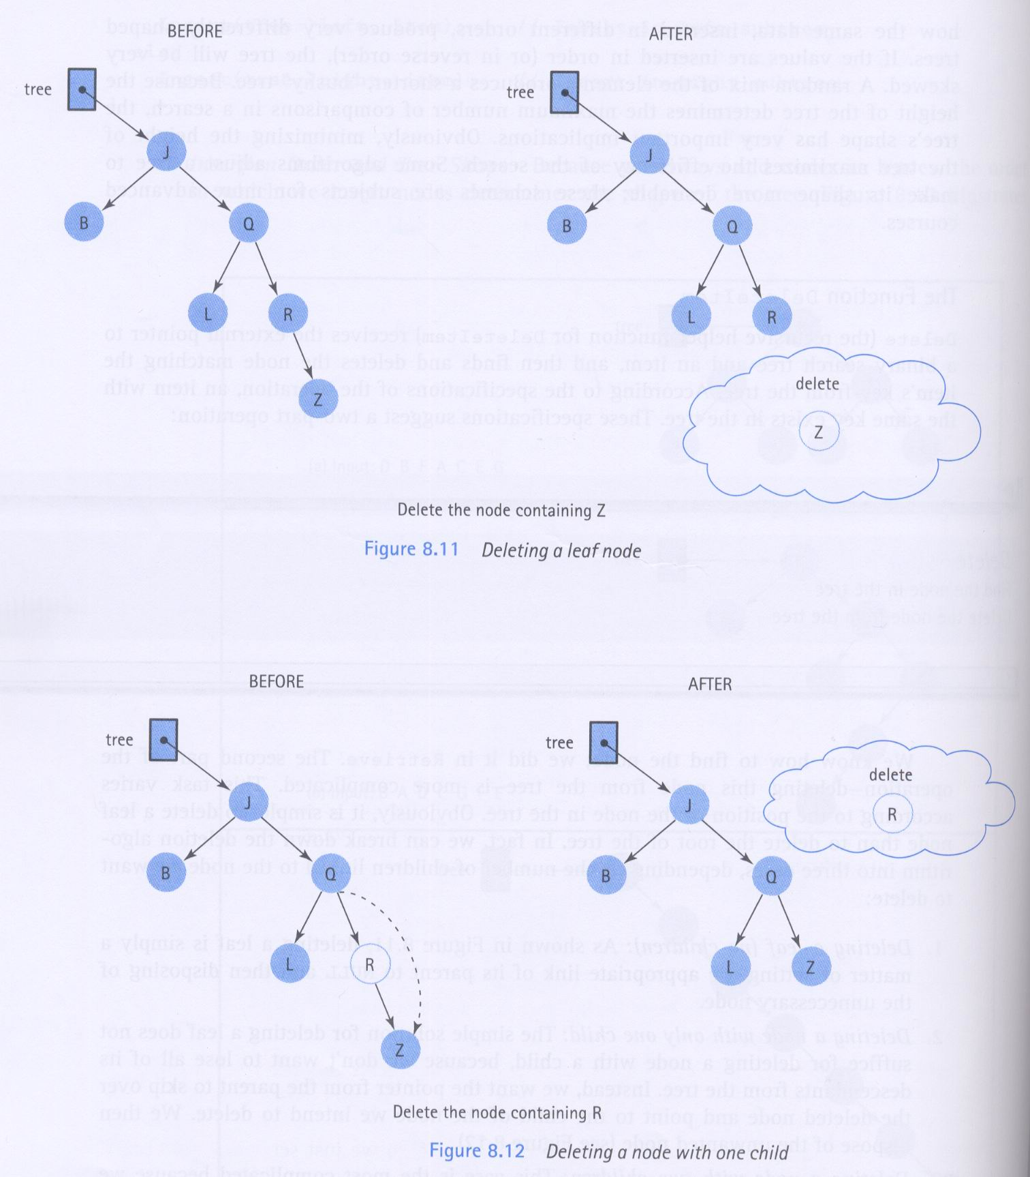
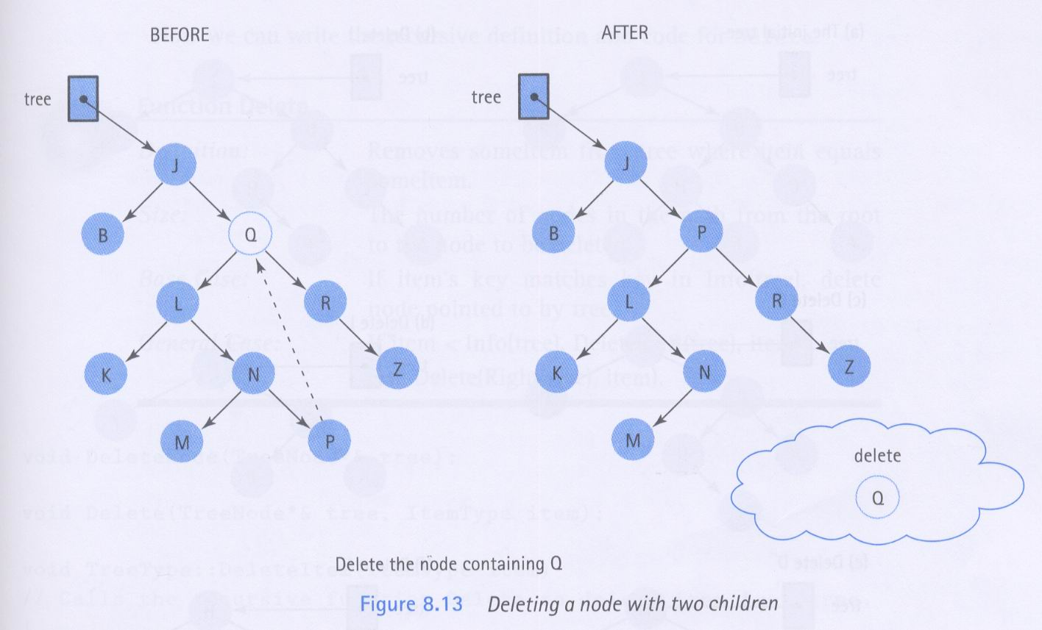
The Function DeleteItem
Base Case:
If item’s key matches key in Info(tree), delete node
General Case:
If item<Info(tree), Delete(Left(tree),item);
Else Delete(Right(tree),item);
46
Notes:
delete 알고리즘은 삭제하려는 노드에 연결된 children의 숫자에 의존
1. leaf 삭제 : (그림 8.11), parent를 NULL로, leaf 삭제
2. 하나의 child를 갖는 노드 삭제 : (그림 8.12), parent가 삭제 노드를 건너뛰어 삭제 노드의 child를 포인트
3. 두 개의 child를 갖는 노드 삭제 : (그림 8.13), 삭제하려는 노드의 info 데이터 멤버를 선행자(삭제하려는 노드의 키 값과 근접하나 작은 노드)의 데이터 멤버로 대체하고 선행자는 삭제. 선행자는 삭제하려는 노드의 왼쪽 서브 트리에 있는 최대 값

Slide 47
Function Delete
void Deleete(TreeNode*& tree, ItemType item);
void TreeType::DeleteItem(ItemType item)
// Calls the recursive function Delete to delete item from tree.
{
Delete(root, item);
}
void Delete(TreeNode*& tree, ItemType item)
// Deletes item from tree
// Post : item is not in tree
{
if (item < tree->info)
Delete(tree->left, item); // Look in left subtree.
else if (item > tree ->info)
Delete(tree->right, item); // Look in right subtree.
else
DeleteNode(tree); // Node found; call DeleteNode.
}

Slide 48
Function DeleteNode()
void GetPredecessor(TreeNode* tree, ItemType data);
void DeleteNode(TreeNode*& tree)
{
ItemType data;
TreeNode* tempPtr;
tempPtr = tree;
if(tree->left == NULL)
{ tree = tree->right; delete tempPtr; }
else if (tree->right == NULL)
{ tree = tree->left; delete tempPtr; }
else
{ GetPredecessor(tree->left, data);
tree->info = data;
Delete(tree->left, data);//Delete predecessor node.
}
}

Slide 49
void GetPredecessor (TreeNode* tree, ItemType& data)
// Sets data to the info member of the rightmost
// node in tree.
{
while(tree->right != NULL)
tree = tree->right;
data = tree->info;
}

Slide 50
Inorder Traversal: A E H J M T Y
Print second
tree
‘J’
‘E’
‘T’
‘A’
‘H’
‘M’
‘Y’
Print left subtree first
Print right subtree last

Slide 51
// INORDER TRAVERSAL
template< class ItemType >
void TreeType<ItemType> :: PrintTree ( ofstream& outFile ) const
{
Print ( root, outFile ) ;
}
template< class ItemType >
void Print( TreeNode<ItemType>* ptr, std::ofstream& outFile )
{ if ( ptr != NULL )
{
Print( ptr->left , outFile ) ; // Print left subtree
outFile << ptr->info ;
Print( ptr->right, outFile ) ; // Print right subtree
}
}
51

Slide 52
Preorder Traversal: J E A H T M Y
Print first
tree
‘J’
‘E’
‘T’
‘A’
‘H’
‘M’
‘Y’
Print left subtree second
Print right subtree last

Slide 53
Postorder Traversal: A H E M Y T J
Print last
tree
‘J’
‘E’
‘T’
‘A’
‘H’
‘M’
‘Y’
Print left subtree first
Print right subtree second

Slide 54
template< class ItemType >
TreeType<ItemType> :: ~TreeType ( ) // DESTRUCTOR
{
Destroy ( root ) ;
}
template< class ItemType >
void Destroy ( TreeNode<ItemType>* ptr )
// Post: All nodes of the tree pointed to by ptr are deallocated.
{ if ( ptr != NULL )
{
Destroy ( ptr->left ) ;
Destroy ( ptr->right ) ;
delete ptr ;
}
}
54

Slide 55
template< class ItemType >
Void TreeType<ItemType> :: ResetTree (OrderType order )
{
switch (order) {
case PRE_ORDER: PreOrder(root, preQue); break;
case IN_ORDER: InOrder(root, inQue); break;
case POST_ORDER: PostOrder(root, postQue); break;
}
template< class ItemType >
void GetNextItem ( ItemType& item, OrderType order, bool& finished )
{ finished = false;
switch (order) {
case PRE_ORDER: preQue.Dequeue(item);
if (preQue.IsEmpty()) finished=True;
break;
case IN_ORDER: inQue.Dequeue(item);
if (inQue.IsEmpty()) finished=True;
break;
case POST_ORDER: postQue.Dequeue(item);
if (postQue.IsEmpty()) finished=True;
break;
}
}

